Slide 1
EMTP AVM Model

Slide 2
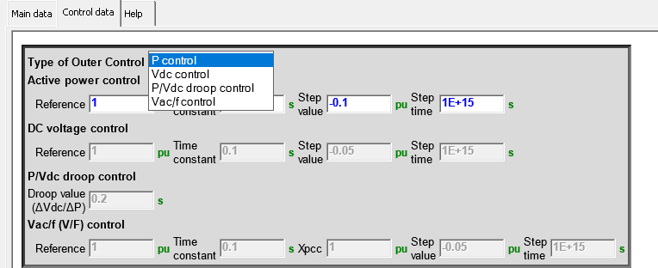
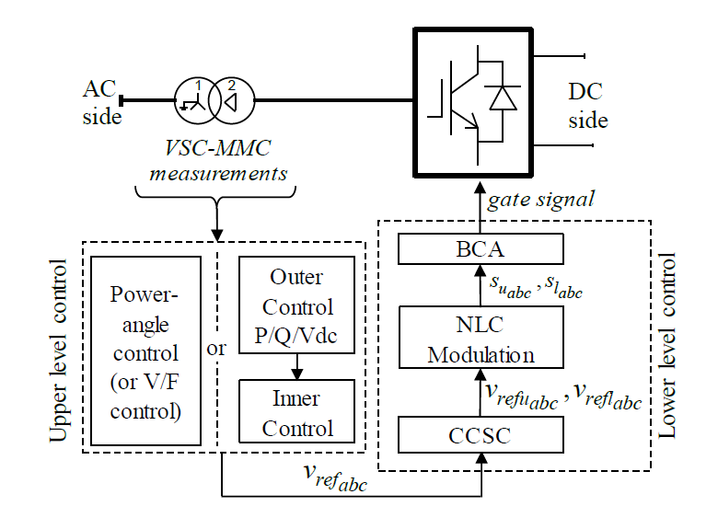
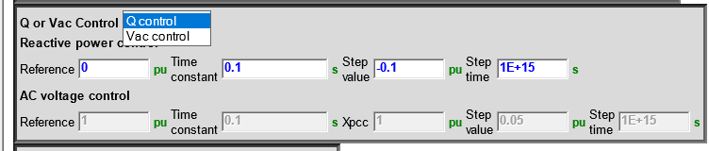
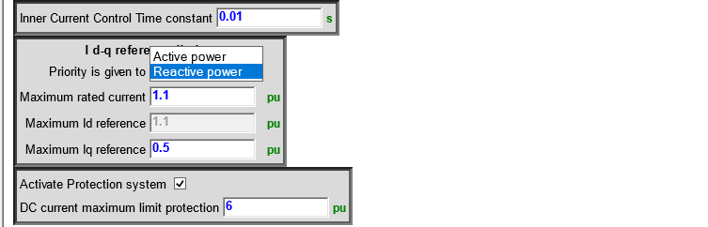
Control Hierarchy for the MMC
Notes:
the power-angle (V/F Control) and vector current controls
Selection of P control from one terminal with Qcontrol
Which selection on the other side of HVDC?
Questions:
In Vac control, not the same Voltage controlled, how to rebuild the voltage on the converter side of the transformer in EMTP?
How to pass from one set of parameters from RMS tools into EMTP set of parameters?

Slide 3
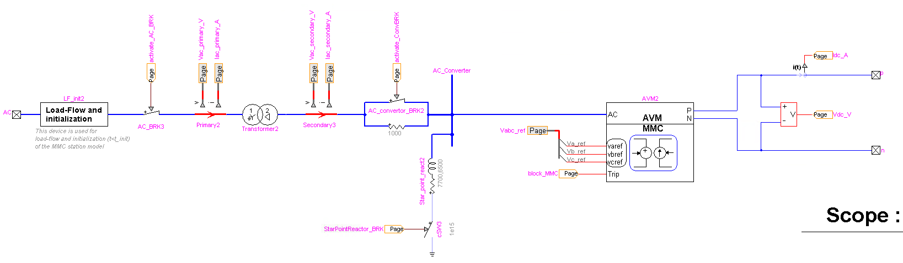
The model is a 1,060 MVA MMC station connected to a 400 kV ac system at the Point of Common Coupling (PCC) through a 400/320 kV step-up transformer and 640 kV pole-to-pole dc voltage
Modelled as PQ bus
Initialization trick, the MMCstation is initially isolated and then immediately (t=1e-15s) switched on for the time domain simulation
Transformer: Yg-delta with 18% impedance
During normal operation, the ac breaker is closed. The breaker is controlled from the protection system. If the protection system is active and a dc overcurrent is detected, the MMC station is tripped (by opening the ac breaker) and the MMC is blocked.
The ac converter breaker is used for the start-up sequence. When it is open, the insertion parallel resistance will limit the current flowing into the MMC.
If the start-up sequence is unchecked, the ac converter breaker is always closed.
Since the secondary winding of the transformer has a Delta connection, the start point reactor is used to give to the MMC a reference to ground.
Notes:
Star point reactor: neglect it.
Leave the transformer as it is and be careful at initialization.
Which L_arm to put?

Slide 4
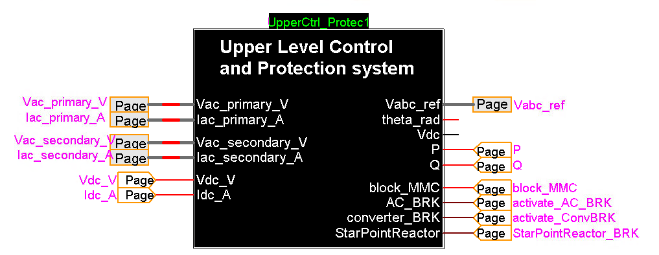
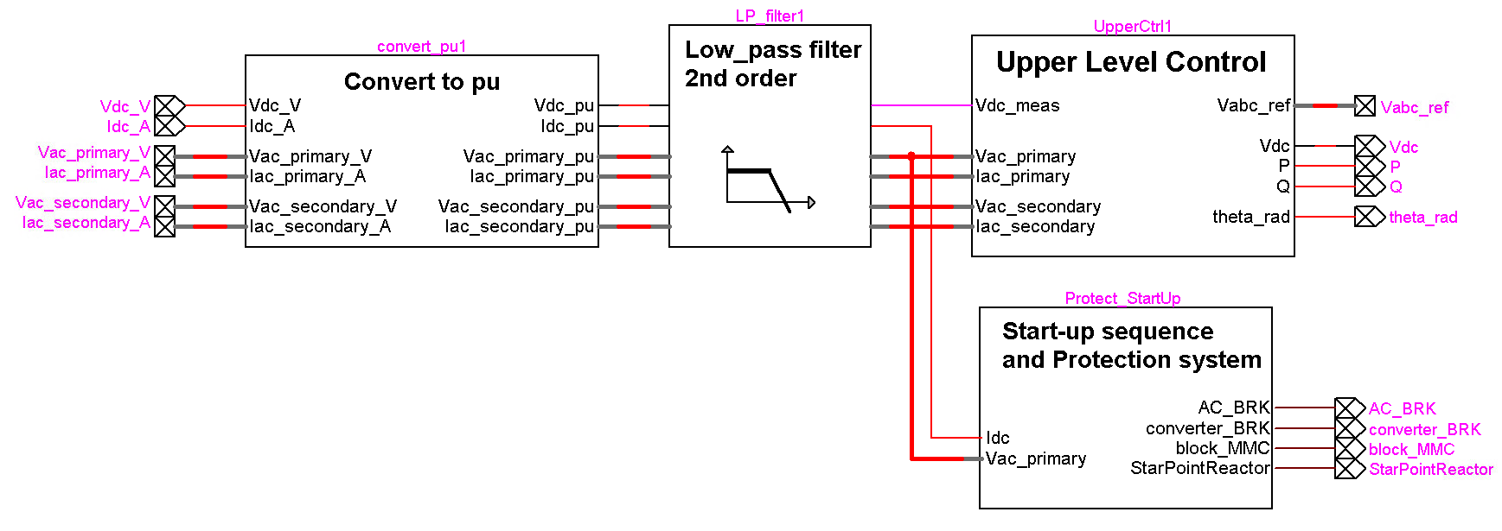
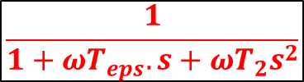
$$\frac{1}{1+ωT_{eps}.s+ωT_{2}s^{2}}$$
Cut_off freq of 2kHz
Notes:
The low pass filter is used to filter the high frequencies from all the measured data.
Should we keep it for the AVM model?

Slide 5
Convert to p.u. Block
//* Fundamental Period
Period = 1 / Freq; // Period (s)
period = 1 / Freq; // Period (s)
w = 2*PI*Freq; // impulse (rad/s)
//* Base calculations
S_VA = S_MVA * 1e6; // Rated apparent power of MMC station (VA)
Vdc_V = Vdc_kV * 1e3; // Rated DC voltage (V)
Vac_primary_VRMSLL = Vac_primary_kVRMSLL * 1e3; // Primary winding AC voltage (VRMSLL)
Vac_secondary_VRMSLL = Vac_secondary_kVRMSLL * 1e3; // Secondary winding AC voltage (VRMSLL)
Vac_primary_V = Vac_primary_VRMSLL * sqrt(2/3); // Primary winding AC voltage (V)
Vac_secondary_V = Vac_secondary_VRMSLL * sqrt(2/3); // Secondary winding AC voltage (V)
Idc_A = S_VA / Vdc_V; // DC current (A)
Iac_primary_A = S_VA / Vac_primary_VRMSLL * sqrt(2 / 3); // Primary winding AC current (A)
Iac_secondary_A = S_VA / Vac_secondary_VRMSLL * sqrt(2 / 3); // Secondary winding AC current (A)
Zbase_primary_Ohm = Vac_primary_VRMSLL * Vac_primary_VRMSLL / S_VA;// Primary winding base impedance (Ohm)
Zbase_secondary_Ohm = Vac_secondary_VRMSLL * Vac_secondary_VRMSLL / S_VA;

Slide 6
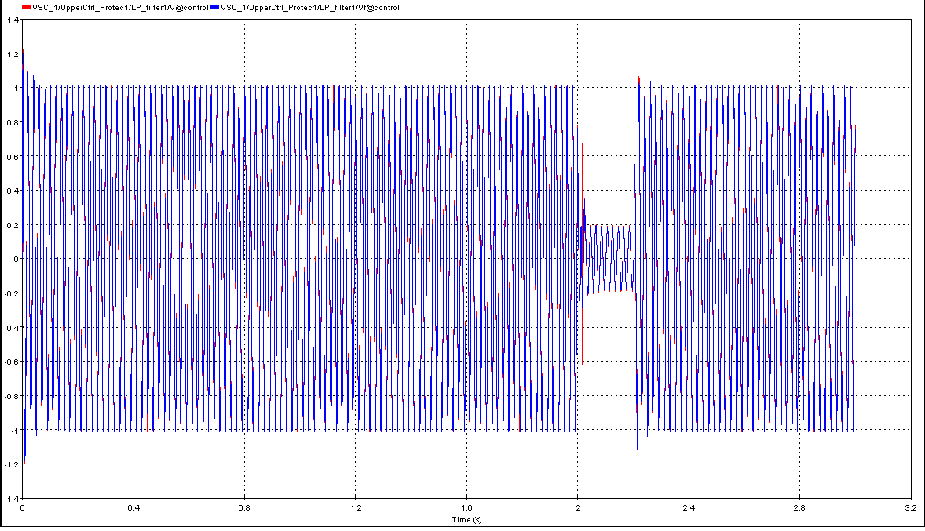
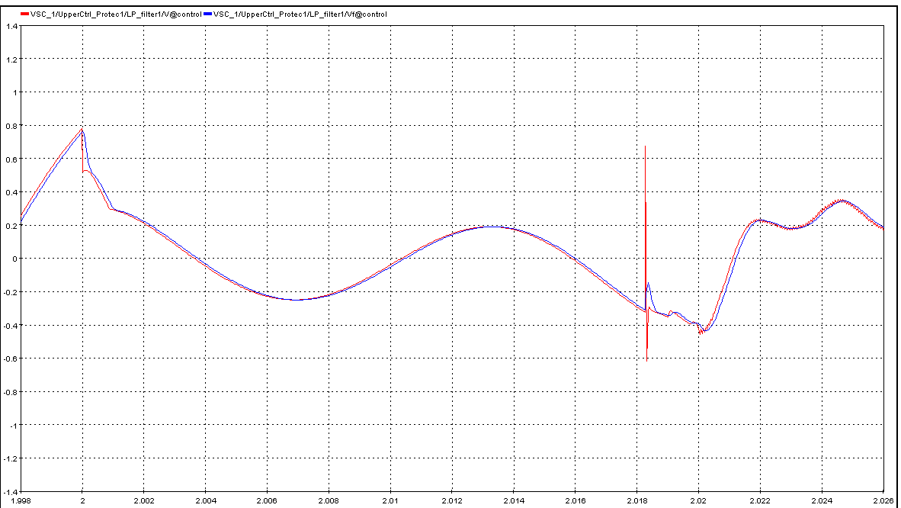
Effect of Filter 2kHz filter for input signals

Slide 7
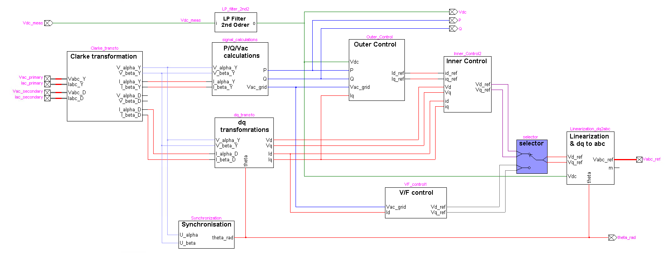
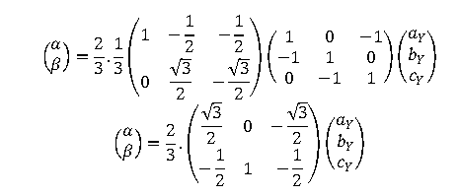
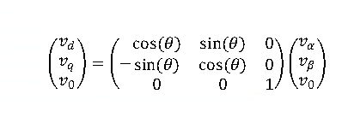
FreqC= 141 Hz
FreqC= 140Hz
P/Q/Vac Calculations
P = (V_alpha_Y*I_alpha_Y) + (V_Beta_Y*I_Beta_Y)
Q = - (V_alpha_Y*I_Beta_Y) + (V_Beta_Y*I_alpha_Y)
Vac_grid=sqrt(V_alpha_Y^2+V_Beta_Y^2)
dq transformation
These P, Q and Vac_grid are passed through Low pass filter of 2nd Order: cutoff frequency=140Hz
Notes:
In all the blocks there is a filter with a cuttof frequency
Split between the Clarke transformation and dq transformation to compute the P and Q values. → why don’t they use vd id vq iq …?

Slide 8
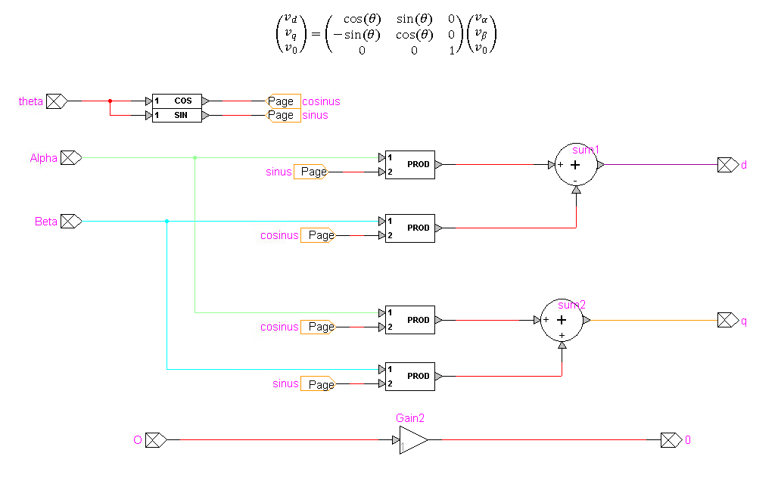
Notes:
Convention ? Different scheme as Thierry.
Take receptor convention in EMTP, instead of Thierry.

Slide 9
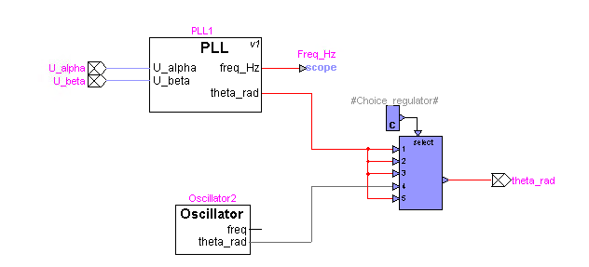
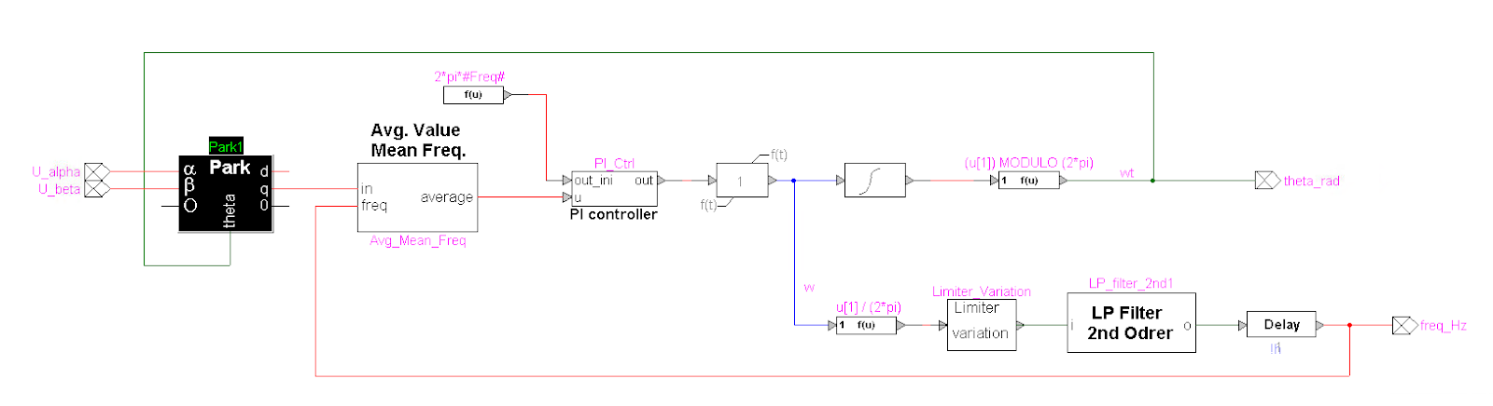
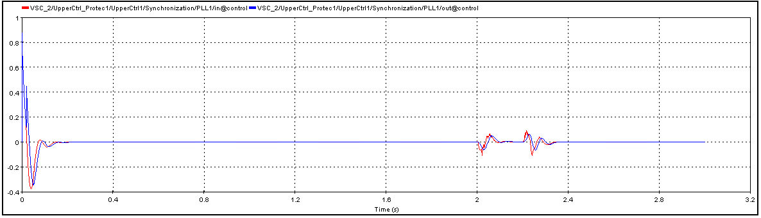
Synchronization block: PLL
Notes:
Additional avg. value mean freq block

Slide 10
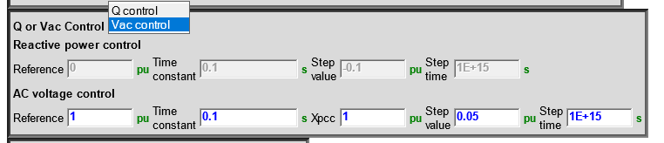
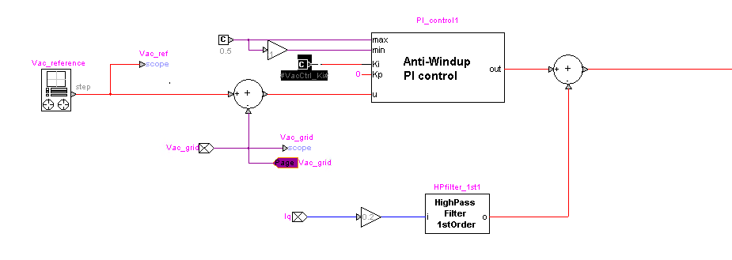
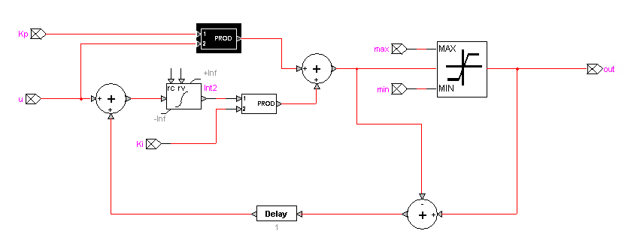
Outer Control: Voltage Control-Iqref
High Pass Filter: FreqC= 8; // cuttof frequency (Hz)
VacCtrl_Ki = 3 / (X_PCC_pu * TimeConstant_V); // Integral Gain of PI control
TimeConstant_V = '100e-3';X_PCC_pu = '1';
VacCtrl_Kp = 0; // Proportional gain of PI control

Slide 11
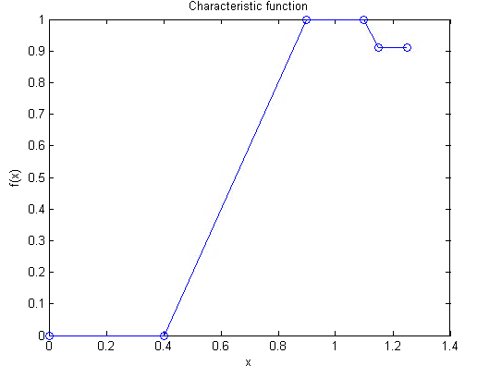

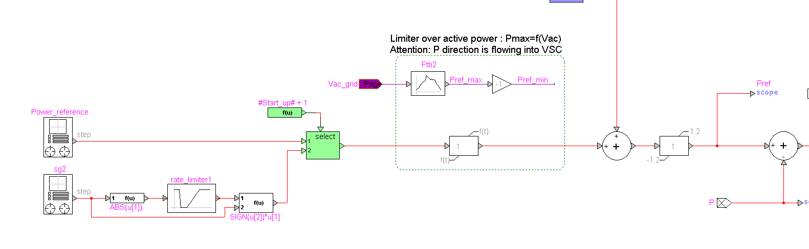
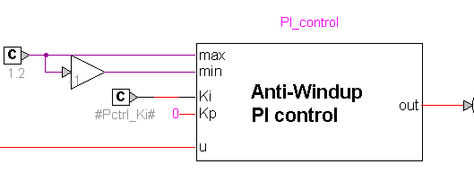
Outer Control: Active Power Control- Idref
The active power control includes a DC voltage limiter that overrides the active power control in order to maintain the DC voltage within an acceptable range. Control limiters are also required to limit the current reference signals going into the inner controller.
Pref generation
Notes:
Clarifies the blocks meaning.
Discrepancies between the two anti wind-up PI controller implementation.

Slide 12
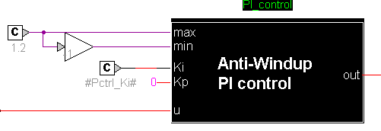
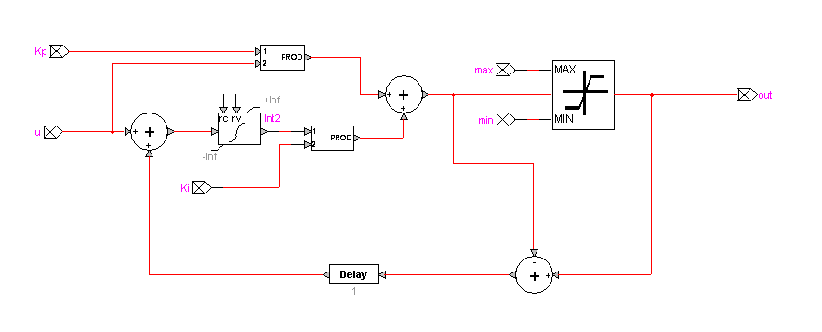
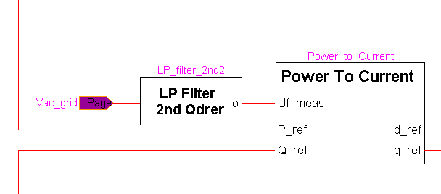
Notes:
Anti-windup is one solution to reduce the effect of saturation. The integrator term grows to large value even while input is saturated.

Slide 13
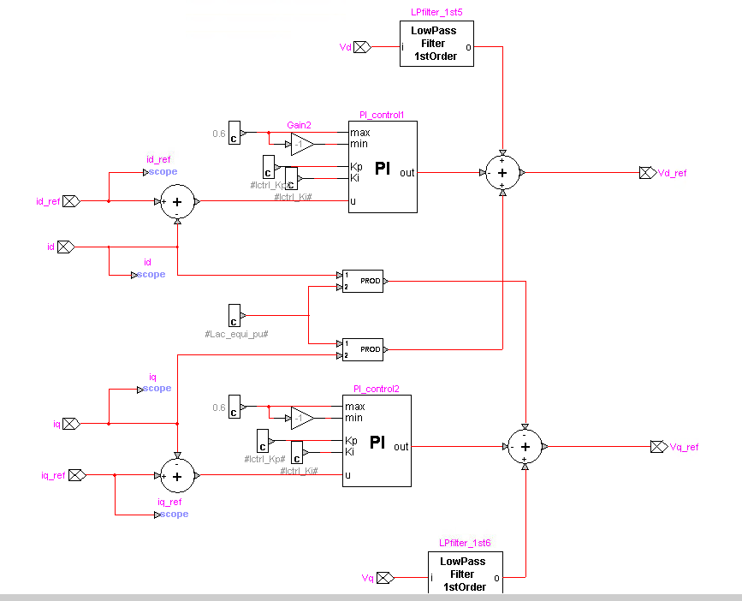
Notes:
D-q current control

Slide 14
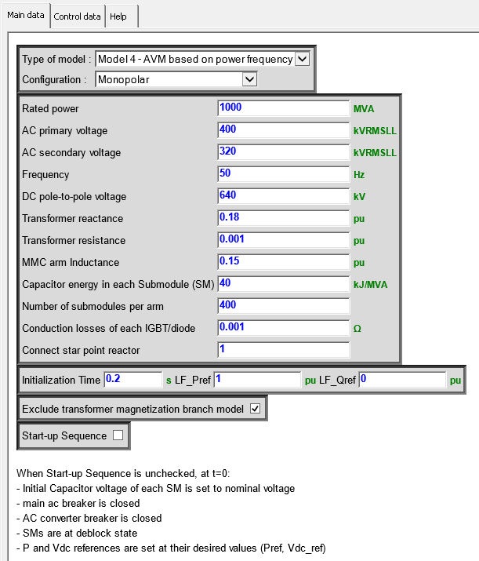
start-up sequence is unchecked

Slide 15
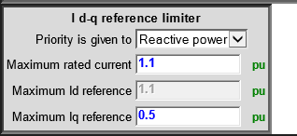
Limiter

Slide 16
